Slide 1

AJAX Intro
Subtitle goes here

Slide 2
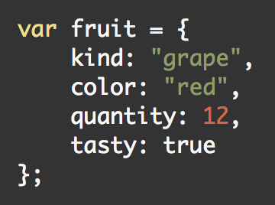
JSON

Slide 3
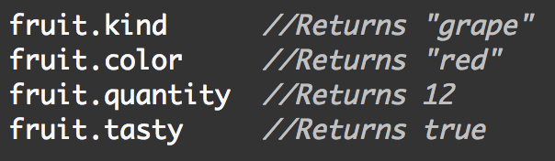
JSON

Slide 4
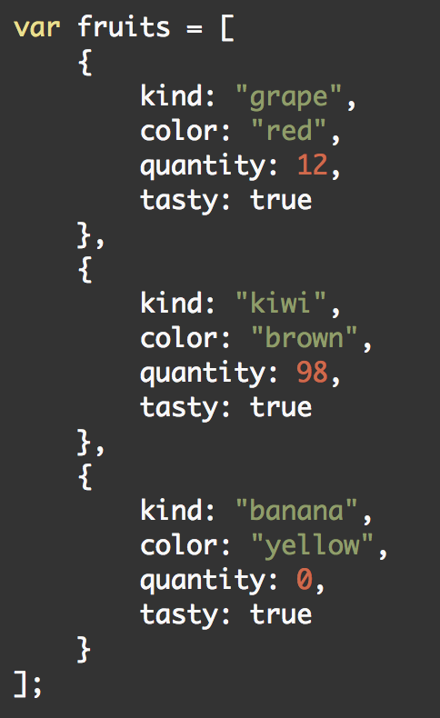
JSON

Slide 5
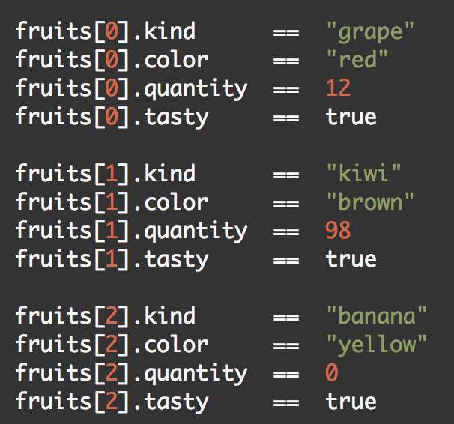
JSON

Slide 6
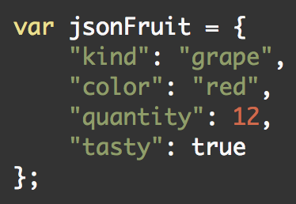
JSON
Notes:
difference? quotes

Slide 8
Let’s load a web page
…in slow motion!

Slide 13
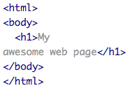

Slide 14
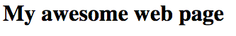

Slide 15
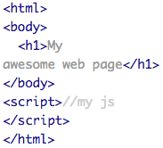

Slide 17
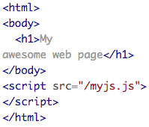

Slide 18
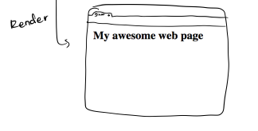


Slide 22
XMLHttpRequest
Another layer: JS can initiate requests
Server: just another GET request (headers)
D3 wraps these with d3.text, d3.json, etc
Get data, work with it in callback!

Slide 23
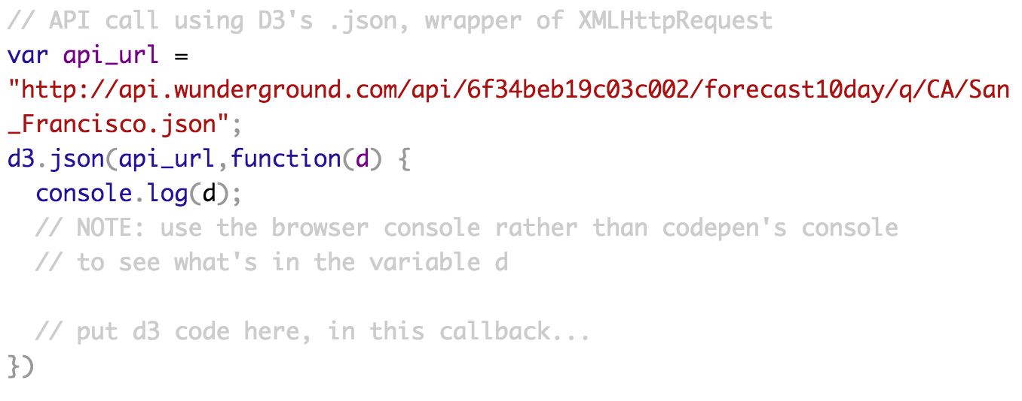

Slide 24
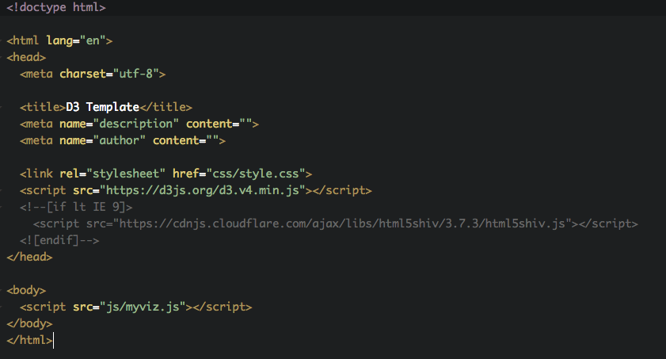
Getting Started With D3 (Murray)

Slide 25
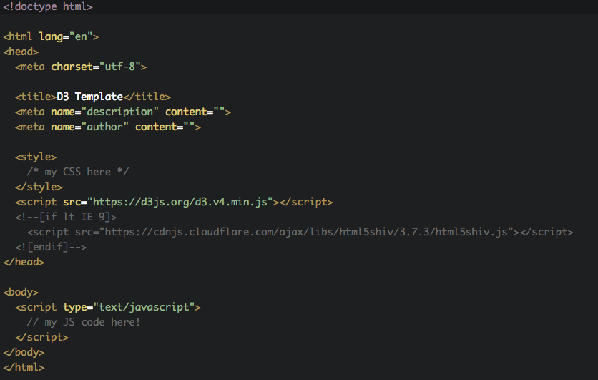
Getting Started

Slide 26
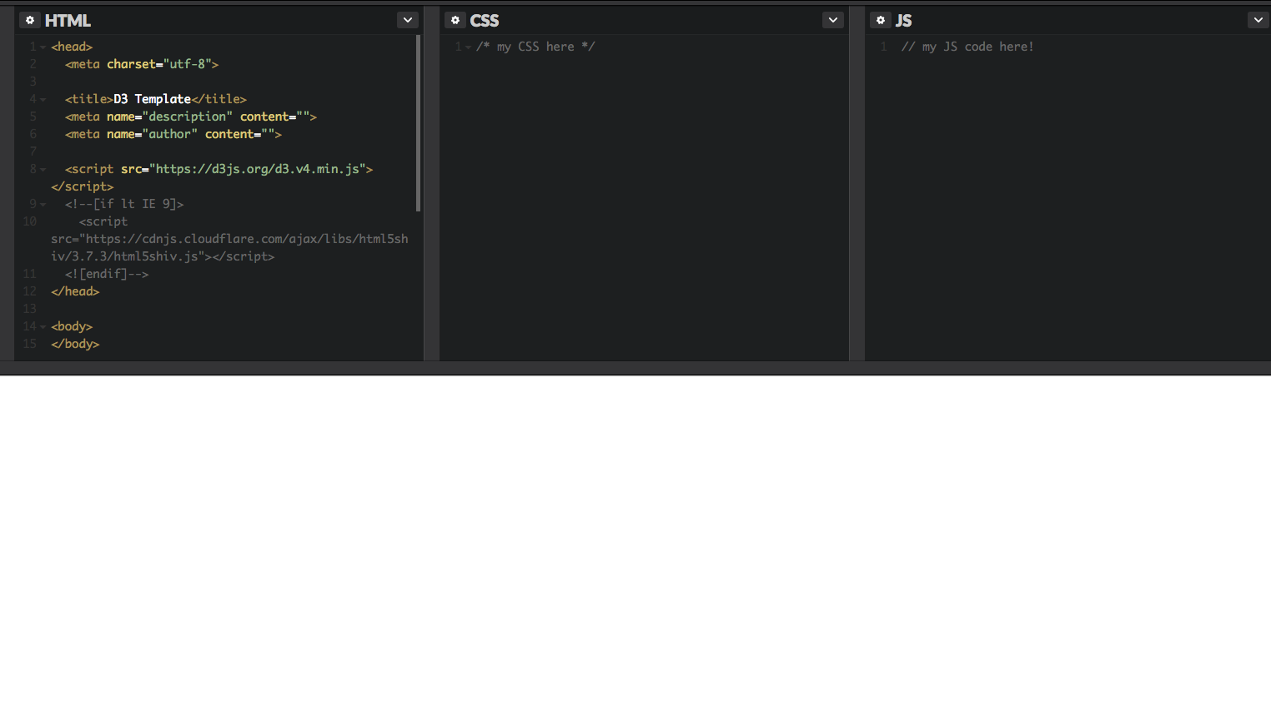
How This Works in CodePen

Slide 27
Let’s take a chance:
http://codepen.io/andyreagan/pen/RGgdAp

Slide 28


